Slide 1
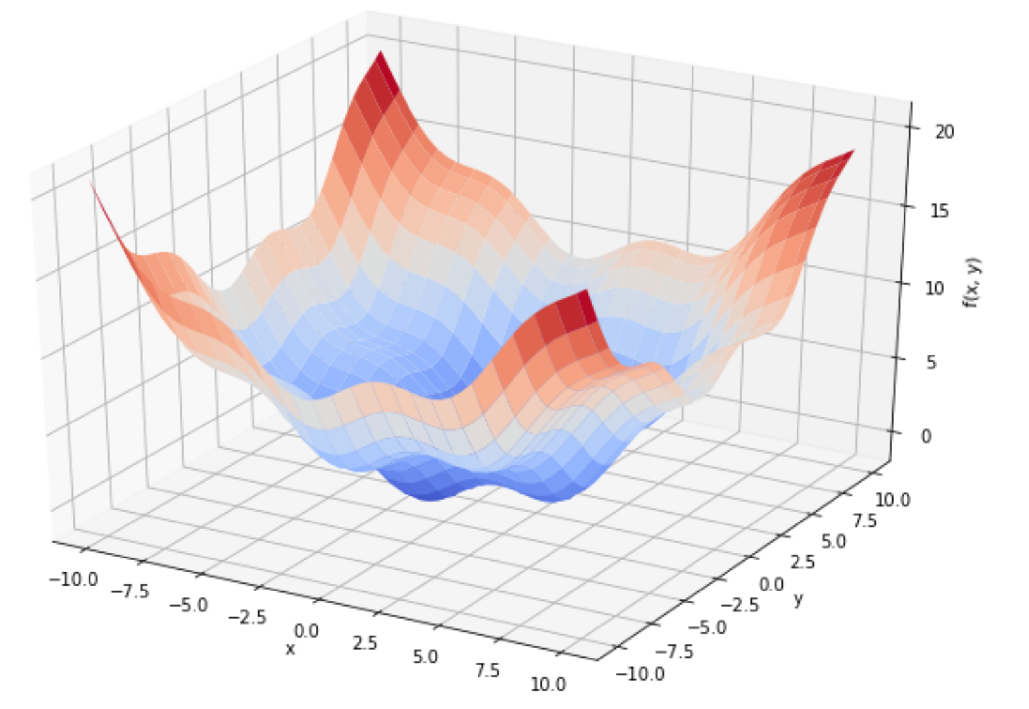

Optimization using scipy

Slide 2
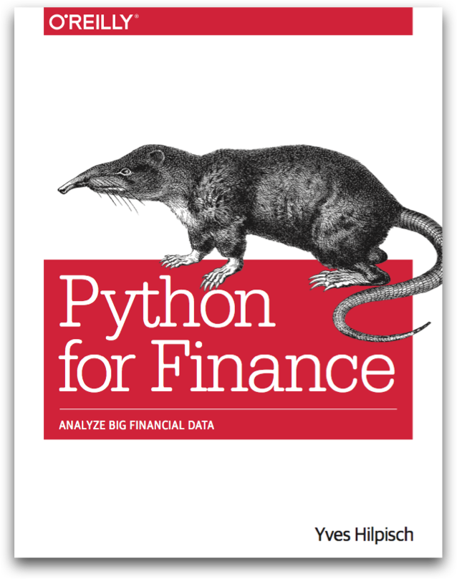
Reference
Chapter 9 of Python for Finance (O'Reilly)
Youtube
Code

Slide 3
np.meshgrid

Slide 4
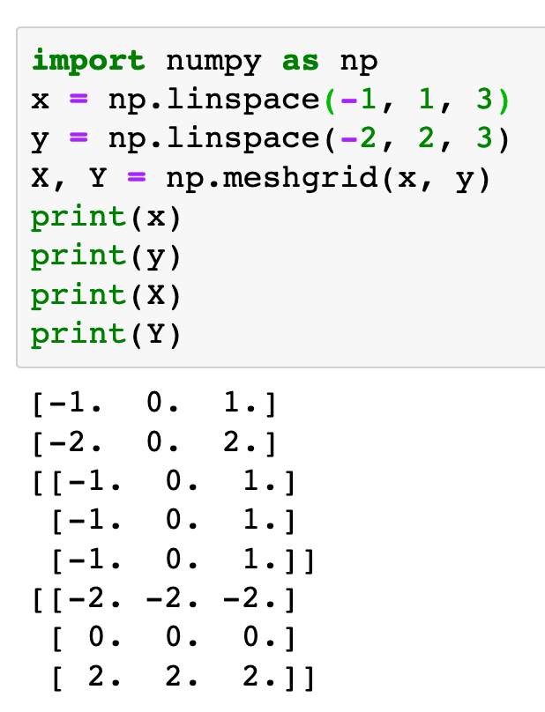
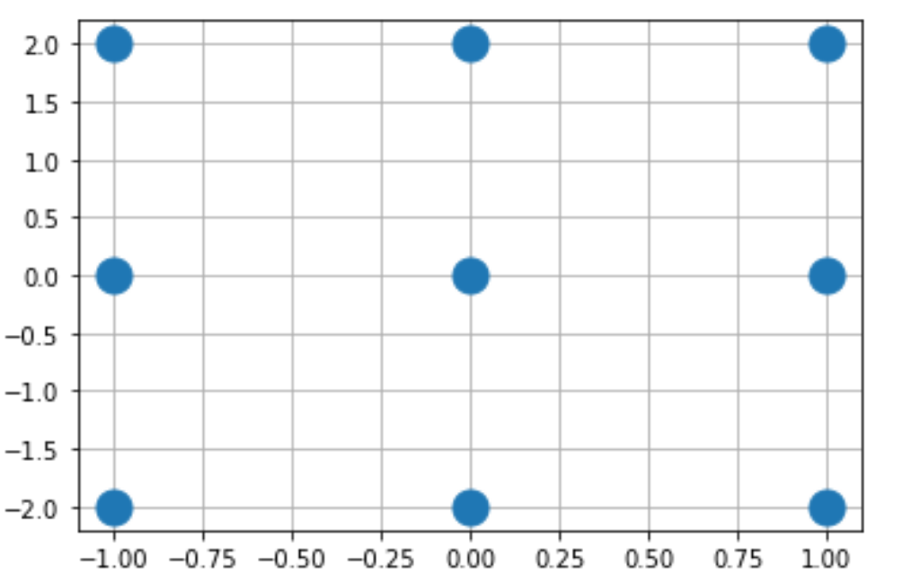

Slide 5
np.meshgrid

Slide 6
Objective Function

Slide 7
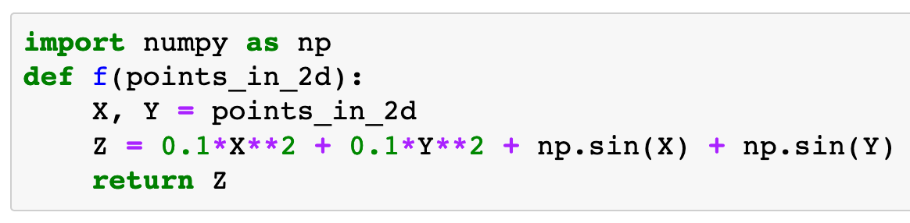

Slide 8
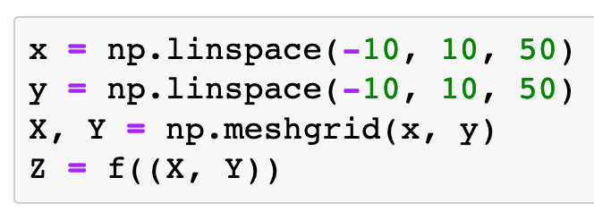

Slide 9
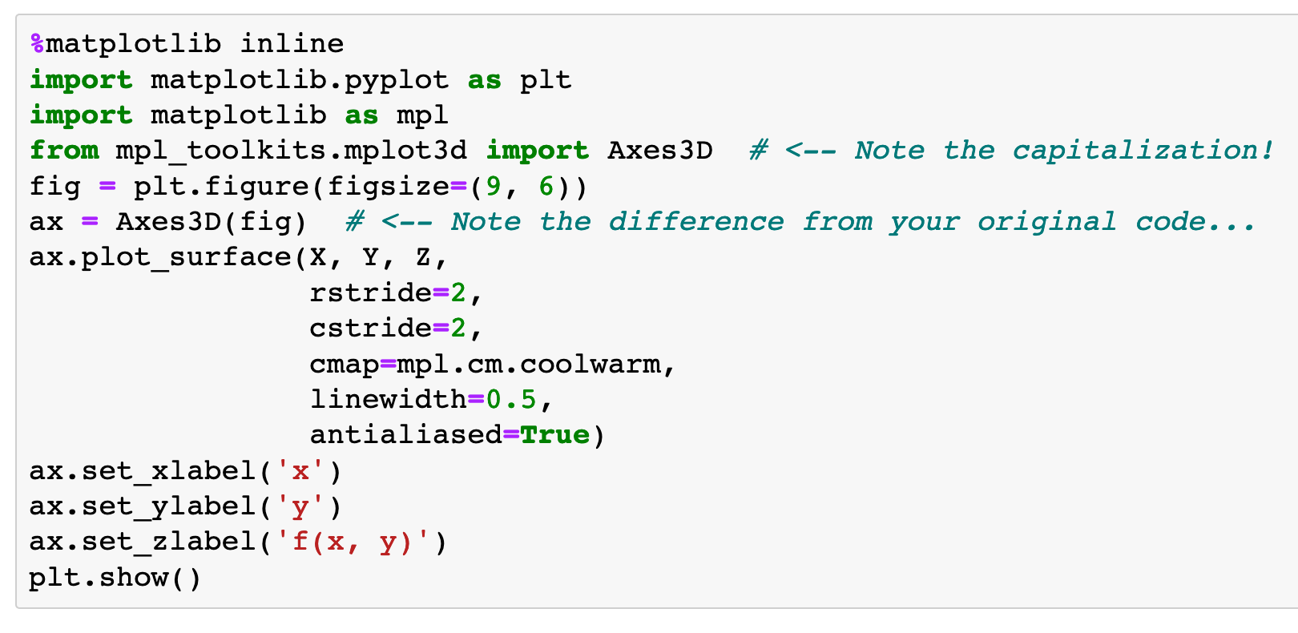
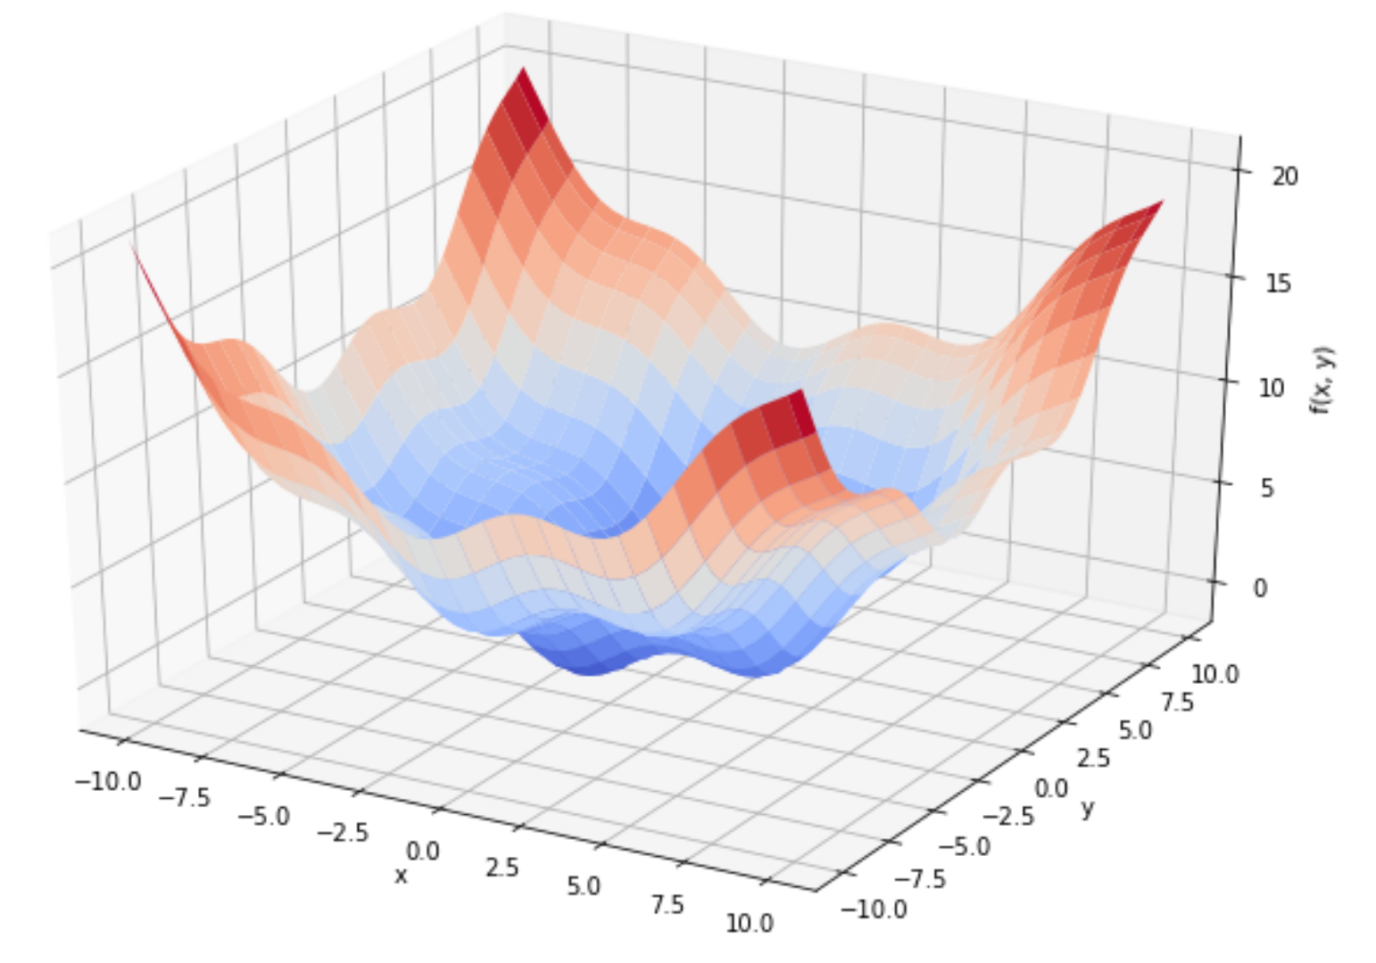

Slide 10
make 3d axes
make 3d axes

Slide 11
plot_surface

Slide 12
matrices

Slide 13
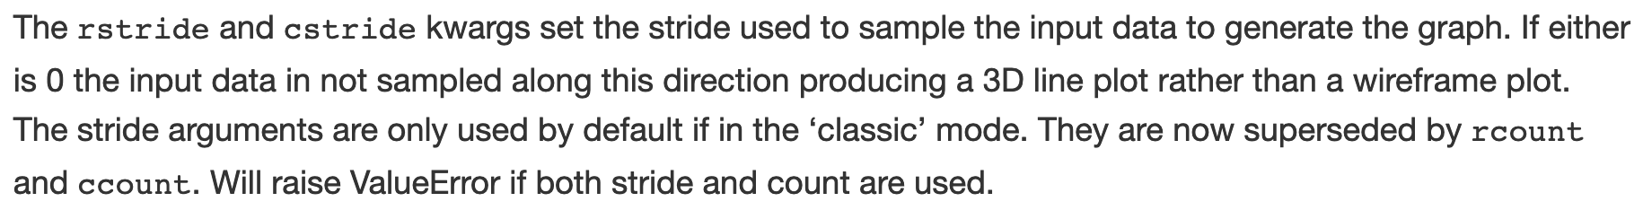

Slide 14
colormap
colormap

Slide 16
Grid Search

Slide 17
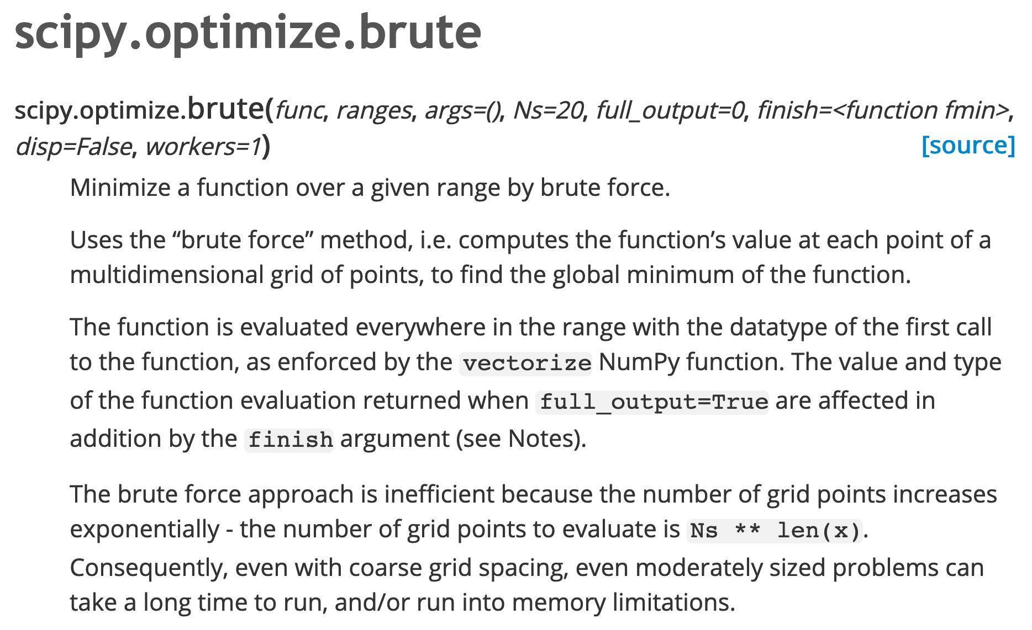

Slide 18
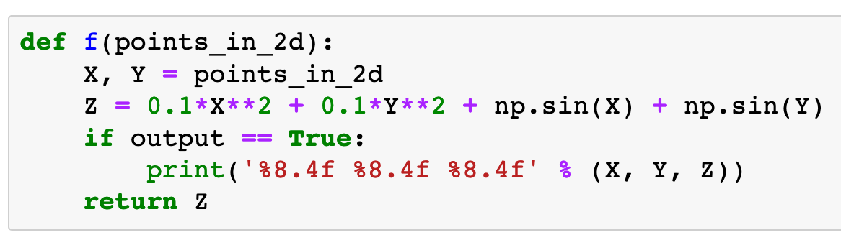

Slide 19
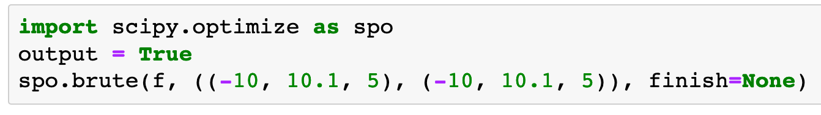
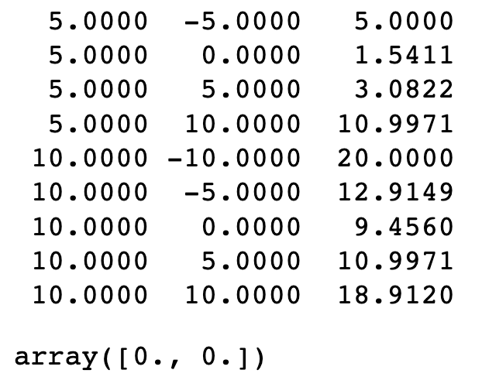

Slide 20
Objective

Slide 21
Grid
Objective

Slide 22
x range

Slide 23
x range
y range

Slide 24
start

Slide 25
start
stop
(exclusive)

Slide 26
start
stop
(exclusive)
step size

Slide 27
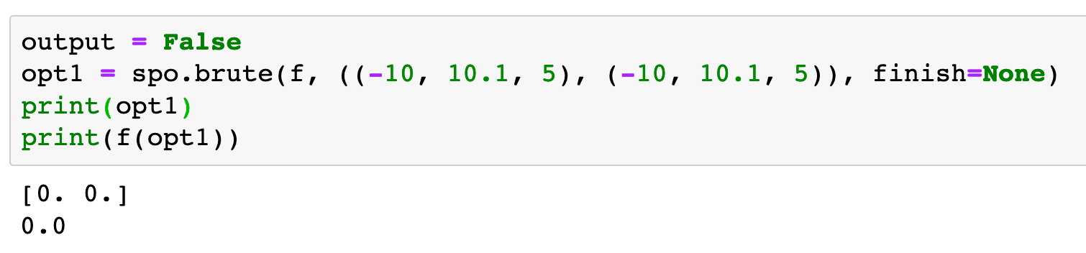
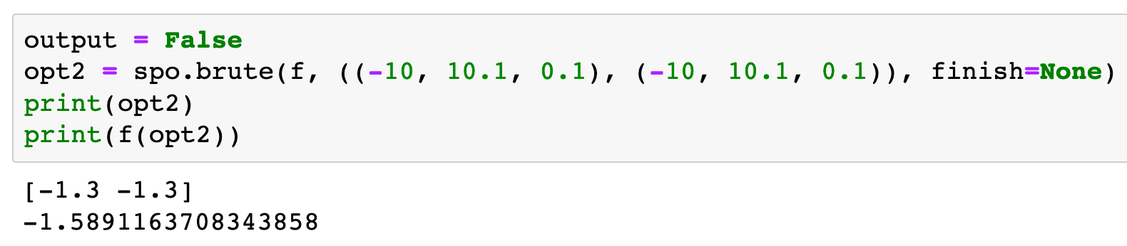

Slide 28
Local Min Search

Slide 29
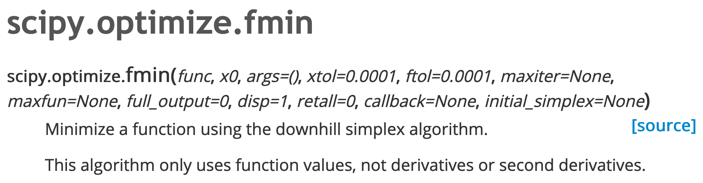

Slide 30
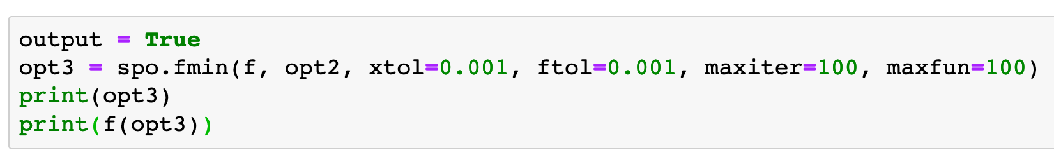
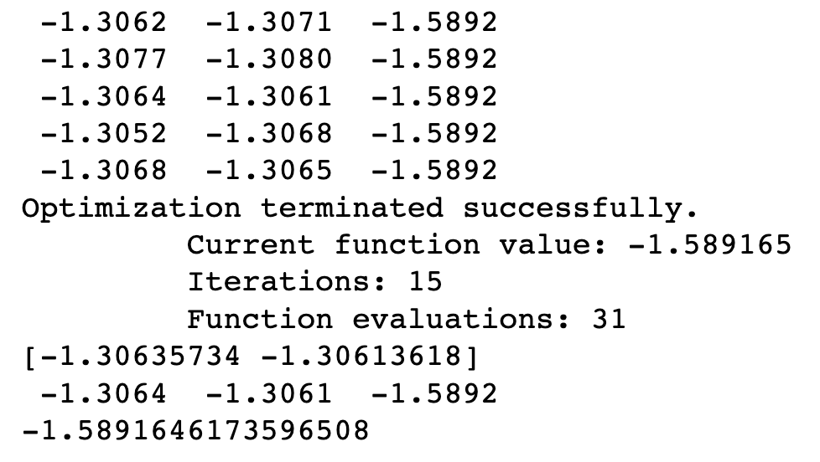

Slide 31
Objective

Slide 32
Objective
Initial

Slide 33
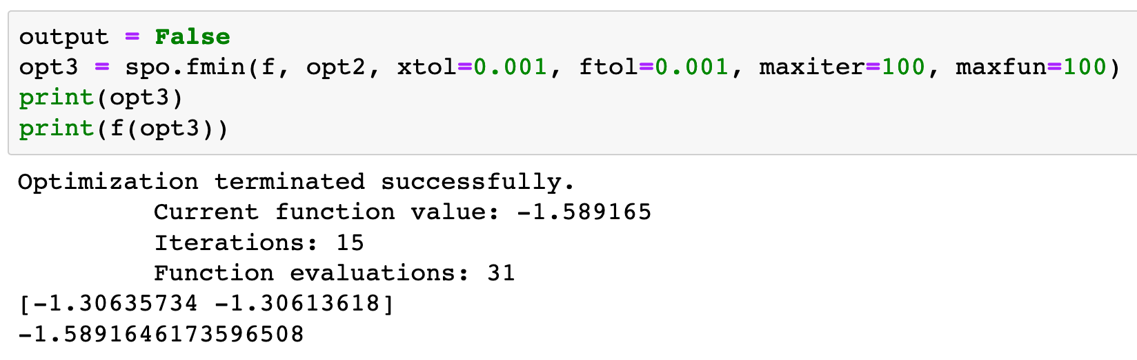

Slide 34
Constrained Optimization

Slide 35
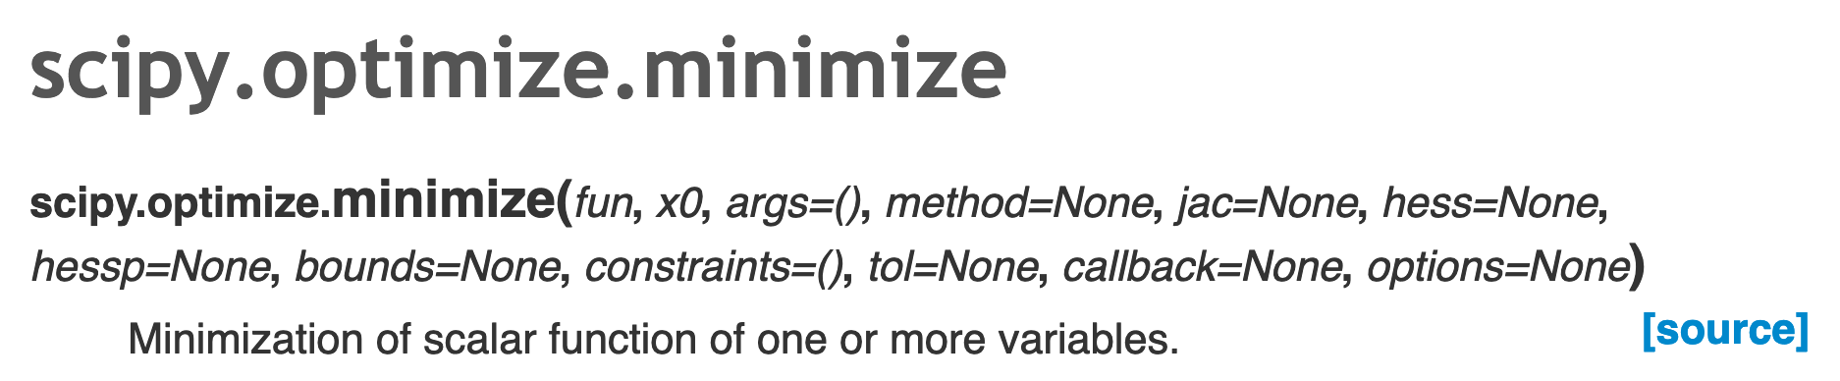

Slide 36
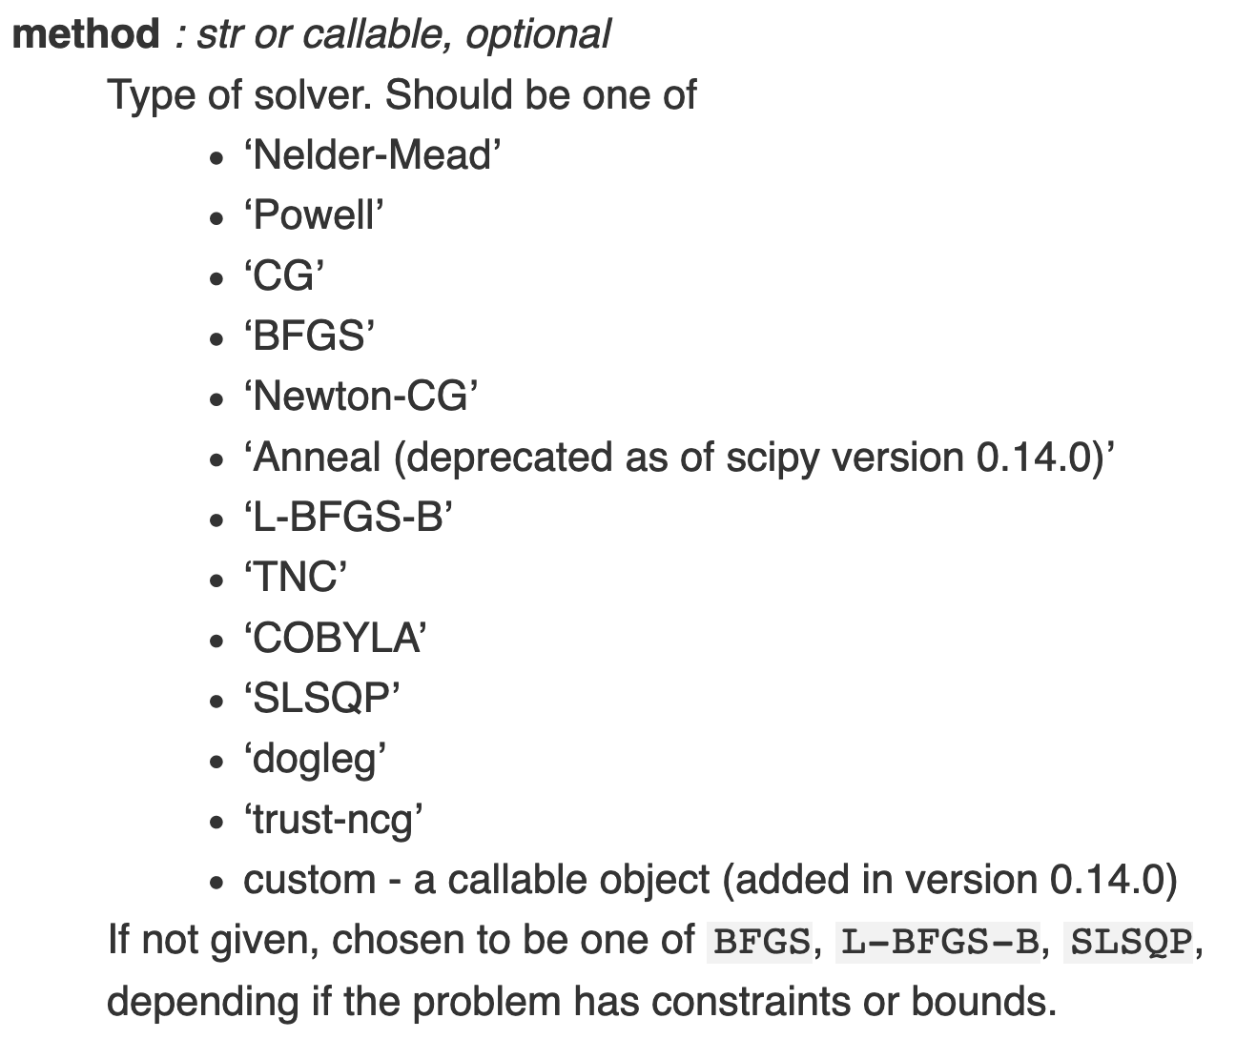

Slide 37
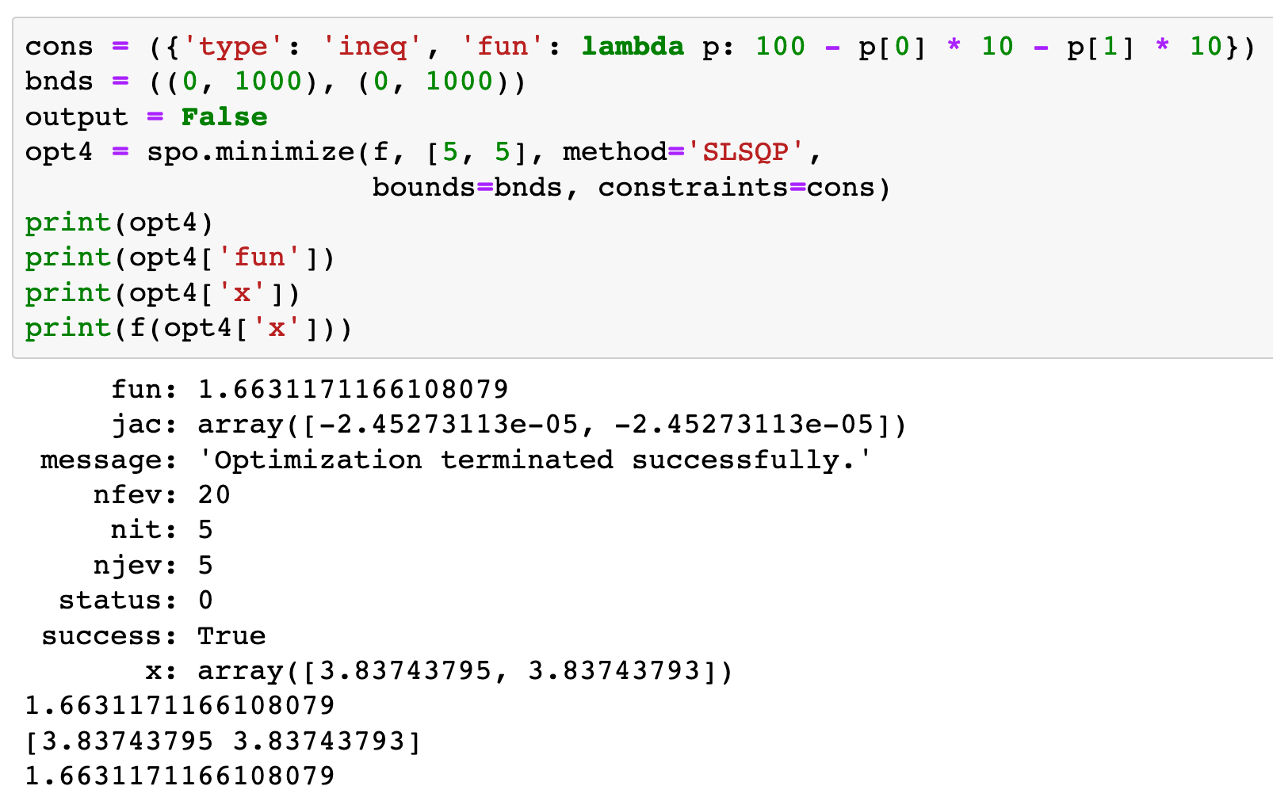

Slide 38
Objective

Slide 39
Objective
Initial

Slide 40
Objective
Initial
Method

Slide 41

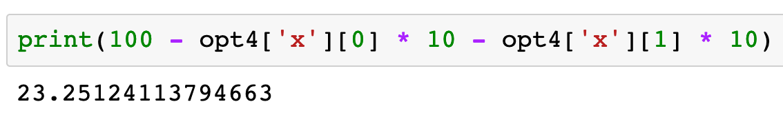
Inequality Constraint

Slide 42
Now
Let’s Play with Code

